Slide 1
Chapter 11: Mass-Storage Systems

Slide 2
Chapter 11: Mass-Storage Systems
Overview of Mass Storage Structure
HDD Scheduling
NVM Scheduling
Error Detection and Correction
Storage Device Management
Swap-Space Management
Storage Attachment
RAID Structure

Slide 3
Objectives
Describe the physical structure of secondary storage devices and the effect of a device’s structure on its uses
Explain the performance characteristics of mass-storage devices
Evaluate I/O scheduling algorithms
Discuss operating-system services provided for mass storage, including RAID

Slide 4
Overview of Mass Storage Structure
Bulk of secondary storage for modern computers is hard disk drives (HDDs) and nonvolatile memory (NVM) devices
HDDs spin platters of magnetically-coated material under moving read-write heads
Drives rotate at 60 to 250 times per second
Transfer rate is rate at which data flow between drive and computer
Positioning time (random-access time) is time to move disk arm to desired cylinder (seek time) and time for desired sector to rotate under the disk head (rotational latency)
Head crash results from disk head making contact with the disk surface -- That’s bad
Disks can be removable

Slide 5
Moving-head Disk Mechanism

Slide 6
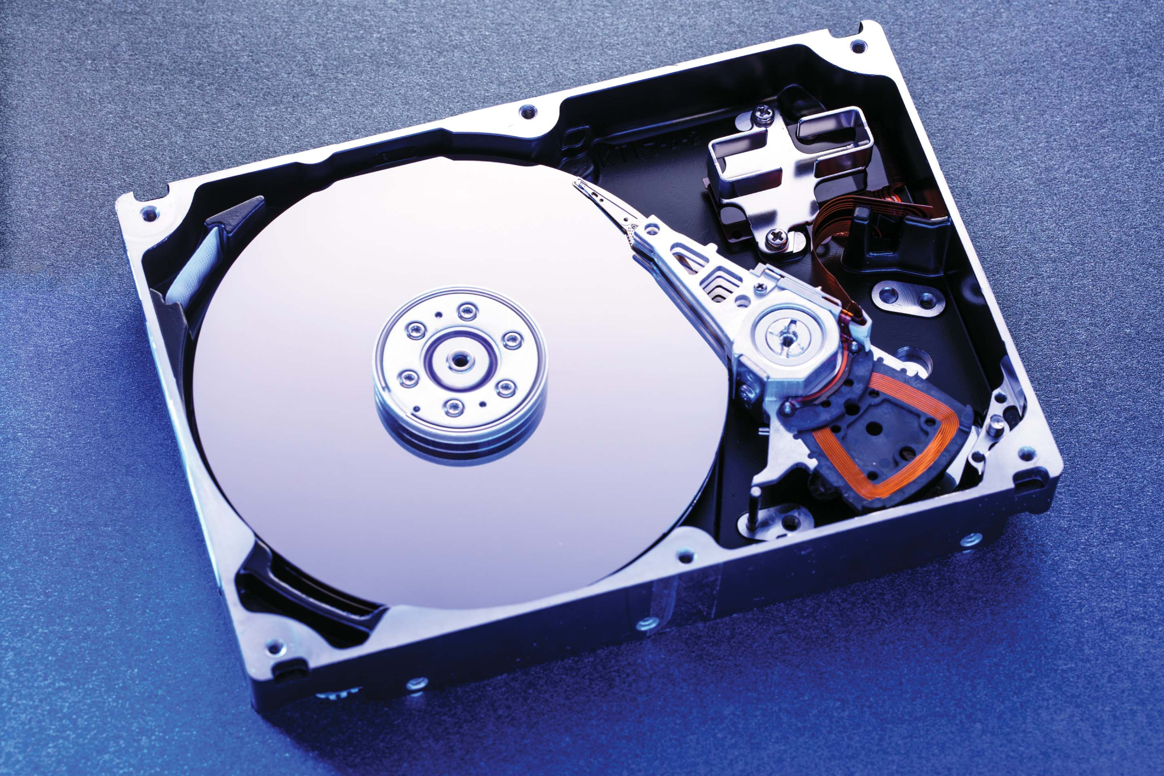
Hard Disk Drives
Platters range from .85” to 14” (historically)
Commonly 3.5”, 2.5”, and 1.8”
Range from 30GB to 3TB per drive
Performance
Transfer Rate – theoretical – 6 Gb/sec
Effective Transfer Rate – real – 1Gb/sec
Seek time from 3ms to 12ms – 9ms common for desktop drives
Average seek time measured or calculated based on 1/3 of tracks
Latency based on spindle speed
1 / (RPM / 60) = 60 / RPM
Average latency = ½ latency

Slide 7
Hard Disk Performance
Access Latency = Average access time = average seek time + average latency (milliseconds)
For fastest disk 3ms + 2ms = 5ms
For slow disk 9ms + 5.56ms = 14.56ms
Average I/O time = average access time + (amount to transfer / transfer rate) + controller overhead
For example to transfer a 4KB block on a 7200 RPM disk with a 5ms average seek time, 1Gb/sec transfer rate with a .1ms controller overhead =
5ms + 4.17ms + 0.1ms + transfer time =
Transfer time = 4KB / 1Gb/s * 8Gb / GB * 1GB / 1024²KB = 32 / (1024²) = 0.031 ms
Average I/O time for 4KB block = 9.27ms + .031ms = 9.301ms

Slide 8
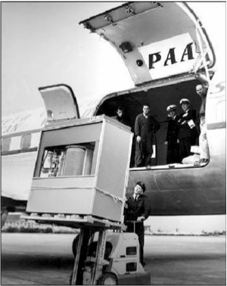
The First Commercial Disk Drive
1956
IBM RAMDAC computer included the IBM Model 350 disk storage system
5M (7 bit) characters
50 x 24” platters
Access time = < 1 second

Slide 9
Nonvolatile Memory Devices
If disk-drive like, then called solid-state disks (SSDs)
Other forms include USB drives (thumb drive, flash drive), DRAM disk replacements, surface-mounted on motherboards, and main storage in devices like smartphones
Can be more reliable than HDDs
More expensive per MB
Maybe have shorter life span – need careful management
Less capacity
But much faster
Busses can be too slow -> connect directly to PCI for example
No moving parts, so no seek time or rotational latency

Slide 10
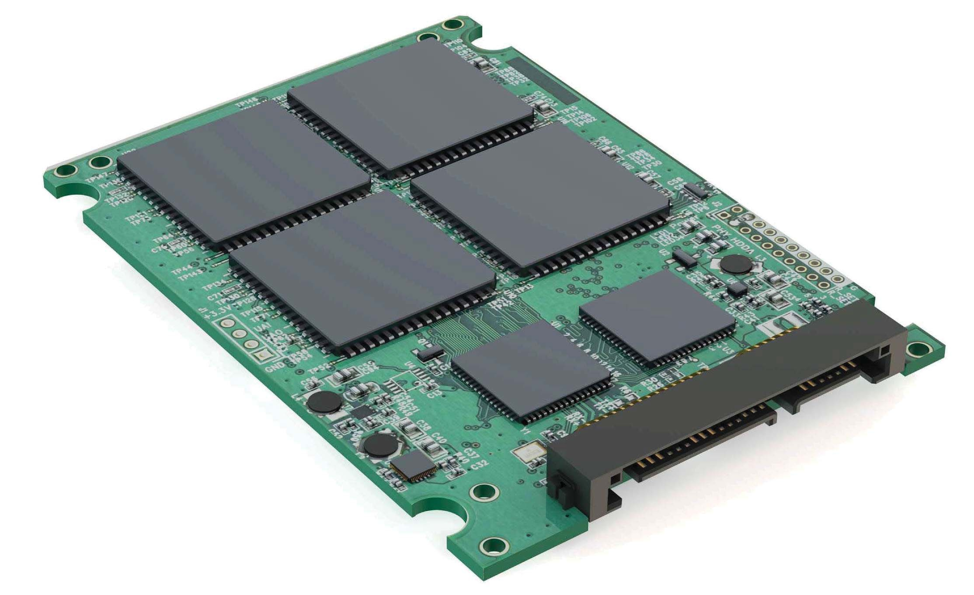
Nonvolatile Memory Devices
Have characteristics that present challenges
Read and written in “page” increments (think sector) but can’t overwrite in place
Must first be erased, and erases happen in larger ”block” increments
Can only be erased a limited number of times before worn out – ~ 100,000
Life span measured in drive writes per day (DWPD)
A 1TB NAND drive with rating of 5DWPD is expected to have 5TB per day written within warrantee period without failing

Slide 11
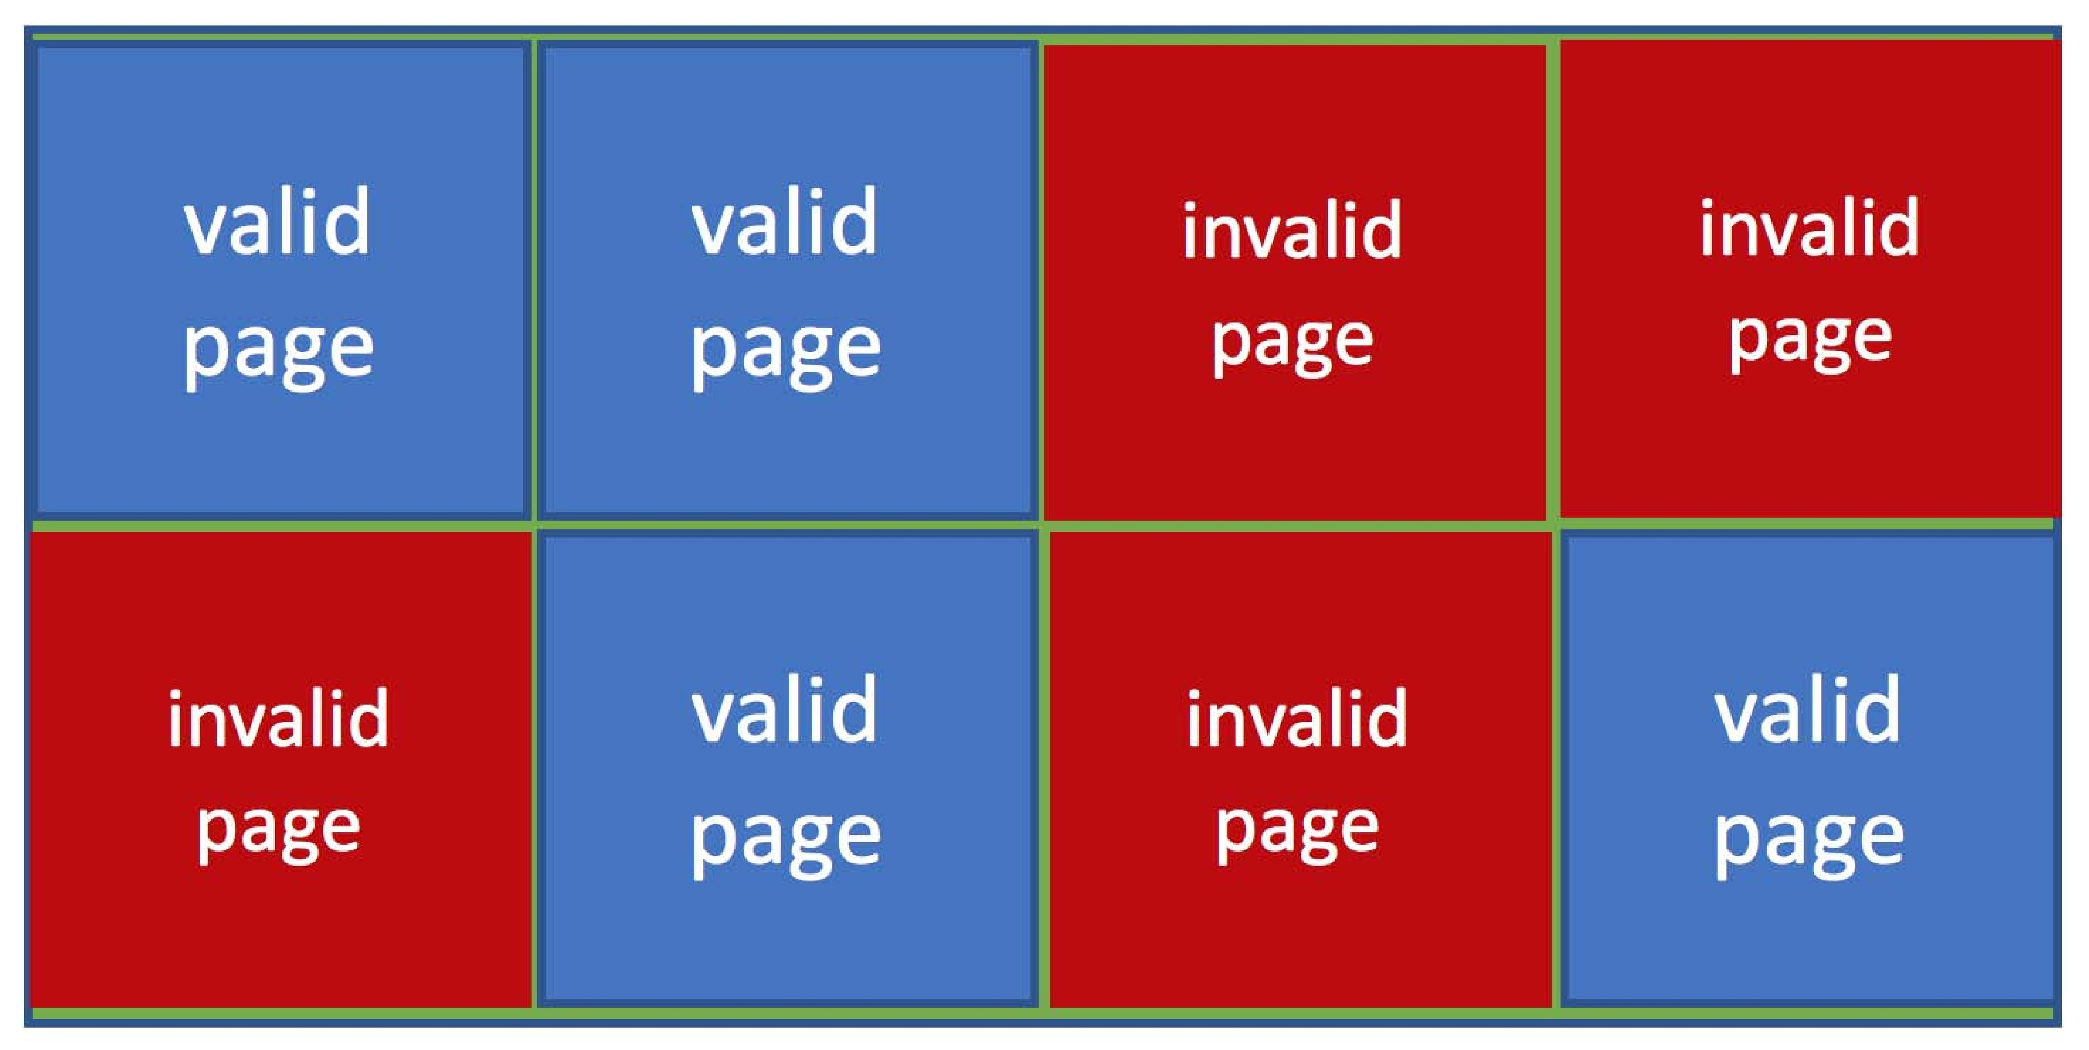
NAND Flash Controller Algorithms
With no overwrite, pages end up with mix of valid and invalid data
To track which logical blocks are valid, controller maintains flash translation layer (FTL) table
Also implements garbage collection to free invalid page space
Allocates overprovisioning to provide working space for GC
Each cell has lifespan, so wear leveling needed to write equally to all cells
NAND block with valid and invalid pages

Slide 12
Volatile Memory
DRAM frequently used as mass-storage device
Not technically secondary storage because volatile, but can have file systems, be used like very fast secondary storage
RAM drives (with many names, including RAM disks) present as raw block devices, commonly file system formatted
Computers have buffering, caching via RAM, so why RAM drives?
Caches / buffers allocated / managed by programmer, operating system, hardware
RAM drives under user control
Found in all major operating systems
Linux /dev/ram, macOS diskutil to create them, Linux /tmp of file system type tmpfs
Used as high speed temporary storage
Programs could share bulk date, quickly, by reading/writing to RAM drive

Slide 13
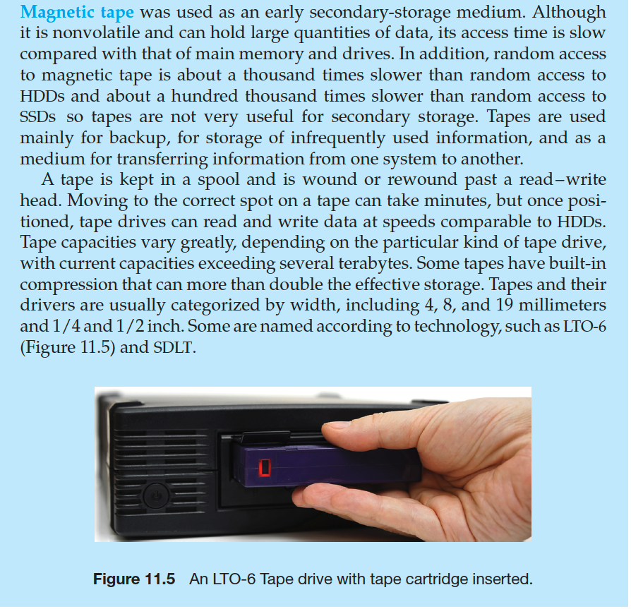
Magnetic Tape

Slide 14
Disk Structure
Disk drives are addressed as large 1-dimensional arrays of logical blocks, where the logical block is the smallest unit of transfer
Low-level formatting creates logical blocks on physical media
The 1-dimensional array of logical blocks is mapped into the sectors of the disk sequentially
Sector 0 is the first sector of the first track on the outermost cylinder
Mapping proceeds in order through that track, then the rest of the tracks in that cylinder, and then through the rest of the cylinders from outermost to innermost
Logical to physical address should be easy
Except for bad sectors
Non-constant # of sectors per track via constant angular velocity

Slide 15
Disk Attachment
Host-attached storage accessed through I/O ports talking to I/O busses
Several busses available, including advanced technology attachment (ATA), serial ATA (SATA), eSATA, serial attached SCSI (SAS), universal serial bus (USB), and fibre channel (FC).
Most common is SATA
Because NVM much faster than HDD, new fast interface for NVM called NVM express (NVMe), connecting directly to PCI bus
Data transfers on a bus carried out by special electronic processors called controllers (or host-bus adapters, HBAs)
Host controller on the computer end of the bus, device controller on device end
Computer places command on host controller, using memory-mapped I/O ports
Host controller sends messages to device controller
Data transferred via DMA between device and computer DRAM

Slide 16
Address Mapping
Disk drives are addressed as large 1-dimensional arrays of logical blocks, where the logical block is the smallest unit of transfer
Low-level formatting creates logical blocks on physical media
The 1-dimensional array of logical blocks is mapped into the sectors of the disk sequentially
Sector 0 is the first sector of the first track on the outermost cylinder
Mapping proceeds in order through that track, then the rest of the tracks in that cylinder, and then through the rest of the cylinders from outermost to innermost
Logical to physical address should be easy
Except for bad sectors
Non-constant # of sectors per track via constant angular velocity

Slide 17
HDD Scheduling
The operating system is responsible for using hardware efficiently — for the disk drives, this means having a fast access time and disk bandwidth
Minimize seek time
Seek time ≈ seek distance
Disk bandwidth is the total number of bytes transferred, divided by the total time between the first request for service and the completion of the last transfer

Slide 18
Disk Scheduling (Cont.)
There are many sources of disk I/O request
OS
System processes
Users processes
I/O request includes input or output mode, disk address, memory address, number of sectors to transfer
OS maintains queue of requests, per disk or device
Idle disk can immediately work on I/O request, busy disk means work must queue
Optimization algorithms only make sense when a queue exists

Slide 19
Disk Scheduling (Cont.)
In the past, operating system responsible for queue management, disk drive head scheduling
Now, built into the storage devices, controllers
Just provide Logical Block Addressing (LBA), handle sorting of requests
Some of the algorithms they use described next

Slide 20
Disk Scheduling (Cont.)
Note that drive controllers have small buffers and can manage a queue of I/O requests (of varying “depth”)
Several algorithms exist to schedule the servicing of disk I/O requests
The analysis is true for one or many platters
We illustrate scheduling algorithms with a request queue (0-199)
98, 183, 37, 122, 14, 124, 65, 67
Head pointer 53

Slide 21
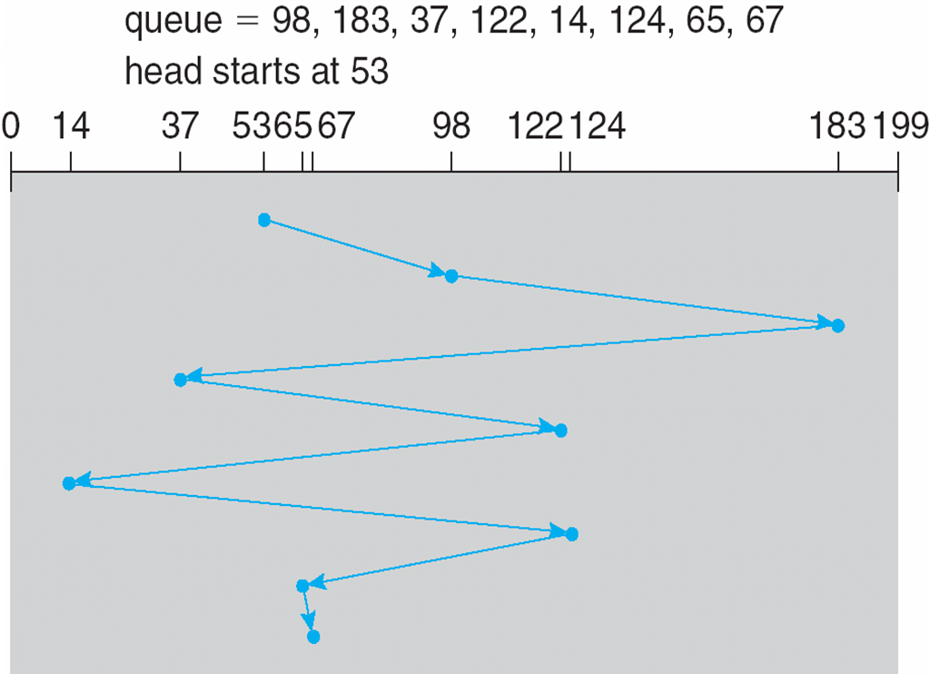
FCFS
Illustration shows total head movement of 640 cylinders

Slide 22
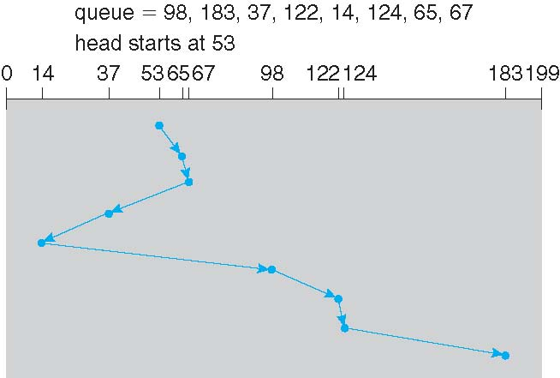
SSTF
Shortest Seek Time First selects the request with the minimum seek time from the current head position
SSTF scheduling is a form of SJF scheduling; may cause starvation of some requests
Illustration shows total head movement of 236 cylinders

Slide 23
SCAN
The disk arm starts at one end of the disk, and moves toward the other end, servicing requests until it gets to the other end of the disk, where the head movement is reversed and servicing continues.
SCAN algorithm Sometimes called the elevator algorithm
Illustration shows total head movement of 208 cylinders
But note that if requests are uniformly dense, largest density at other end of disk and those wait the longest

Slide 24
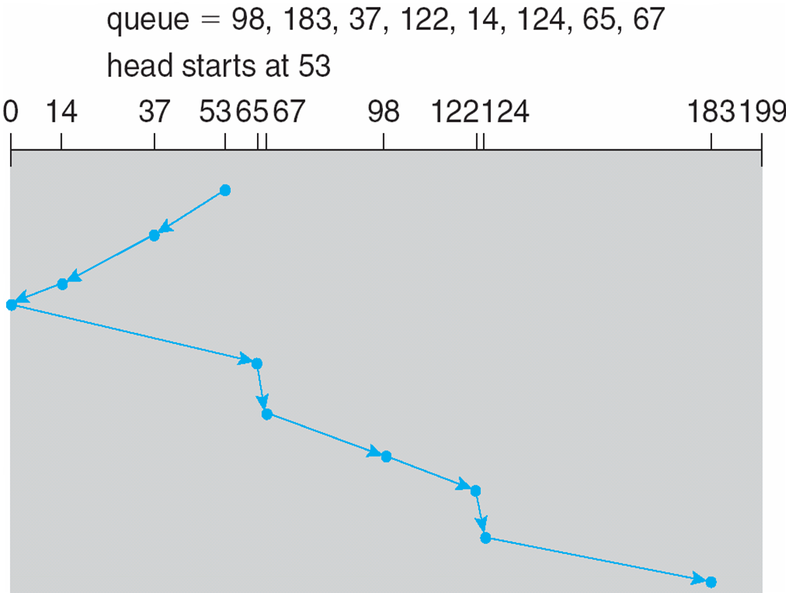
SCAN (Cont.)

Slide 25
C-SCAN
Provides a more uniform wait time than SCAN
The head moves from one end of the disk to the other, servicing requests as it goes
When it reaches the other end, however, it immediately returns to the beginning of the disk, without servicing any requests on the return trip
Treats the cylinders as a circular list that wraps around from the last cylinder to the first one
Total number of cylinders?

Slide 26
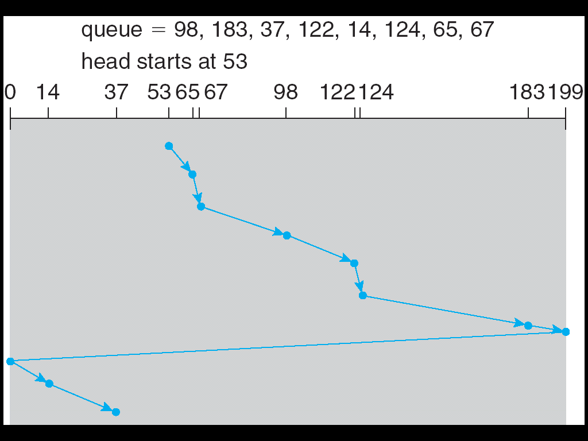
C-SCAN (Cont.)

Slide 27
Selecting a Disk-Scheduling Algorithm
SSTF is common and has a natural appeal
SCAN and C-SCAN perform better for systems that place a heavy load on the disk
Less starvation, but still possible

Slide 28
Selecting a Disk-Scheduling Algorithm
To avoid starvation Linux implements deadline scheduler
Maintains separate read and write queues, gives read priority
Because processes more likely to block on read than write
Implements four queues: 2 x read and 2 x write
1 read and 1 write queue sorted in LBA order, essentially implementing C-SCAN
1 read and 1 write queue sorted in FCFS order
All I/O requests sent in batch sorted in that queue’s order
After each batch, checks if any requests in FCFS older than configured age (default 500ms)
If so, Logical Block Addressing (LBA) queue containing that request is selected for next batch of I/O
In Red Hat (RHEL 7) also NOOP and completely fair queueing scheduler (CFQ) also available, defaults vary by storage device

Slide 29
NVM Scheduling
No disk heads or rotational latency but still room for optimization
In RHEL 7 NOOP (no scheduling) is used but adjacent LBA requests are combined
NVM best at random I/O, HDD at sequential
Throughput can be similar
Input/Output operations per second (IOPS) much higher with NVM (hundreds of thousands vs hundreds)
But write amplification (one write, causing garbage collection and many read/writes) can decrease the performance advantage

Slide 30
Error Detection and Correction
Fundamental aspect of many parts of computing (memory, networking, storage)
Error detection determines if there a problem has occurred (for example a bit flipping)
If detected, can halt the operation
Detection frequently done via parity bit
Parity is one form of checksum – uses modular arithmetic to compute, store, compare values of fixed-length words
Another error-detection method common in networking is cyclic redundancy check (CRC) which uses hash function to detect multiple-bit errors
Error-correction code (ECC) not only detects, but can correct some errors
Soft errors correctable, hard errors detected but not corrected

Slide 31
Storage Device Management
Low-level formatting, or physical formatting — Dividing a disk into sectors that the disk controller can read and write
Each sector can hold header information, plus data, plus error correction code (ECC)
Usually 512 bytes of data but can be selectable
To use a disk to hold files, the operating system still needs to record its own data structures on the disk
Partition the disk into one or more groups of cylinders, each treated as a logical disk
Logical formatting or “making a file system”
To increase efficiency most file systems group blocks into clusters
Disk I/O done in blocks
File I/O done in clusters

Slide 32
Storage Device Management (cont.)
Root partition contains the OS, other partitions can hold other Oses, other file systems, or be raw
Mounted at boot time
Other partitions can mount automatically or manually
At mount time, file system consistency checked
Is all metadata correct?
If not, fix it, try again
If yes, add to mount table, allow access
Boot block can point to boot volume or boot loader set of blocks that contain enough code to know how to load the kernel from the file system
Or a boot management program for multi-os booting

Slide 33
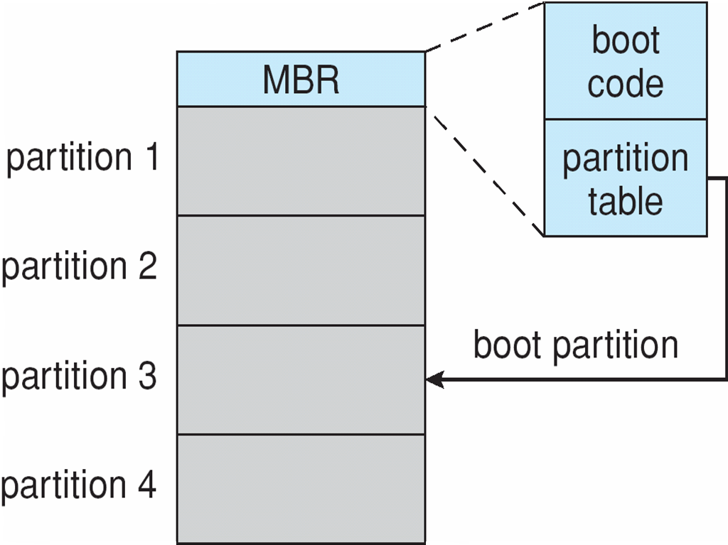
Device Storage Management (Cont.)
Raw disk access for apps that want to do their own block management, keep OS out of the way (databases for example)
Boot block initializes system
The bootstrap is stored in ROM, firmware
Bootstrap loader program stored in boot blocks of boot partition
Methods such as sector sparing used to handle bad blocks
Booting from secondary storage in Windows

Slide 34
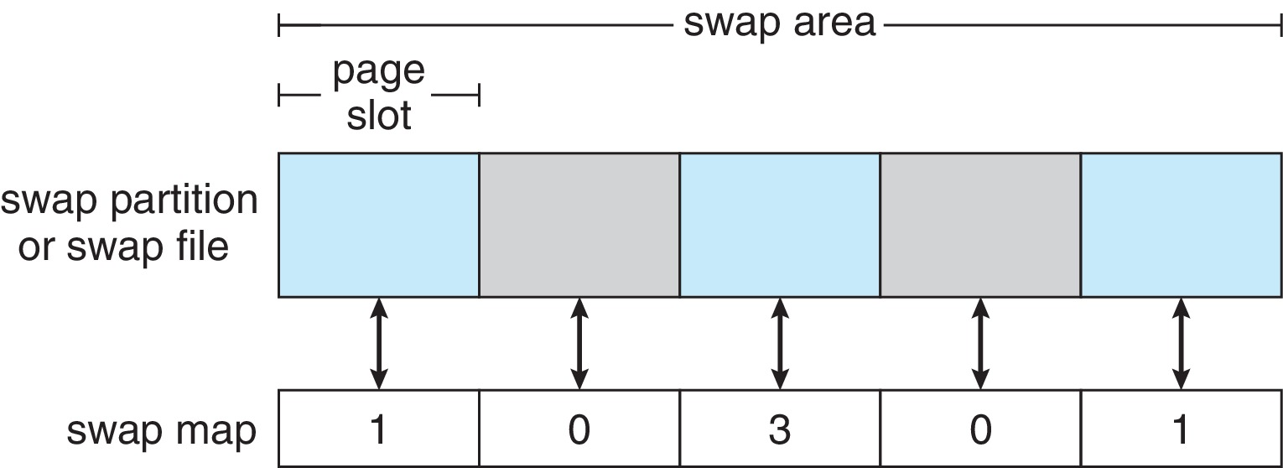
Swap-Space Management
Used for moving entire processes (swapping), or pages (paging), from DRAM to secondary storage when DRAM not large enough for all processes
Operating system provides swap space management
Secondary storage slower than DRAM, so important to optimize performance
Usually multiple swap spaces possible – decreasing I/O load on any given device
Best to have dedicated devices
Can be in raw partition or a file within a file system (for convenience of adding)
Data structures for swapping on Linux systems:

Slide 35
Storage Attachment
Computers access storage in three ways
Host-attached
Network-attached
Cloud
Host attached access through local I/O ports, using one of several technologies
To attach many devices, use storage busses such as USB, firewire, thunderbolt
High-end systems use fibre channel (FC)
High-speed serial architecture using fibre or copper cables
Multiple hosts and storage devices can connect to the FC fabric

Slide 36
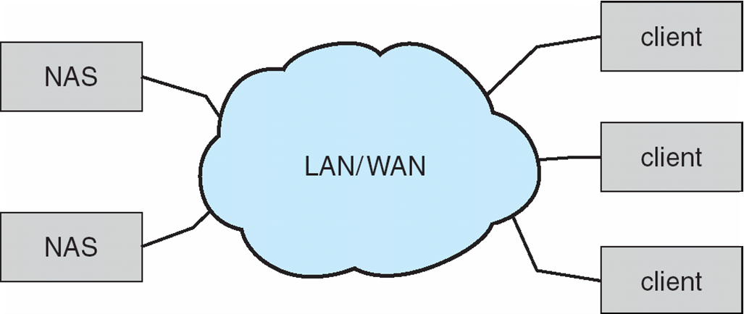
Network-Attached Storage
Network-attached storage (NAS) is storage made available over a network rather than over a local connection (such as a bus)
Remotely attaching to file systems
NFS and CIFS are common protocols
Implemented via remote procedure calls (RPCs) between host and storage over typically TCP or UDP on IP network
iSCSI protocol uses IP network to carry the SCSI protocol
Remotely attaching to devices (blocks)

Slide 37
Cloud Storage
Similar to NAS, provides access to storage across a network
Unlike NAS, accessed over the Internet or a WAN to remote data center
NAS presented as just another file system, while cloud storage is API based, with programs using the APIs to provide access
Examples include Dropbox, Amazon S3, Microsoft OneDrive, Apple iCloud
Use APIs because of latency and failure scenarios (NAS protocols wouldn’t work well)

Slide 38
Storage Array
Can just attach disks, or arrays of disks
Avoids the NAS drawback of using network bandwidth
Storage Array has controller(s), provides features to attached host(s)
Ports to connect hosts to array
Memory, controlling software (sometimes NVRAM, etc.)
A few to thousands of disks
RAID, hot spares, hot swap (discussed later)
Shared storage -> more efficiency
Features found in some file systems
Snaphots, clones, thin provisioning, replication, deduplication, etc

Slide 39
Storage Area Network
Common in large storage environments
Multiple hosts attached to multiple storage arrays – flexible

Slide 40
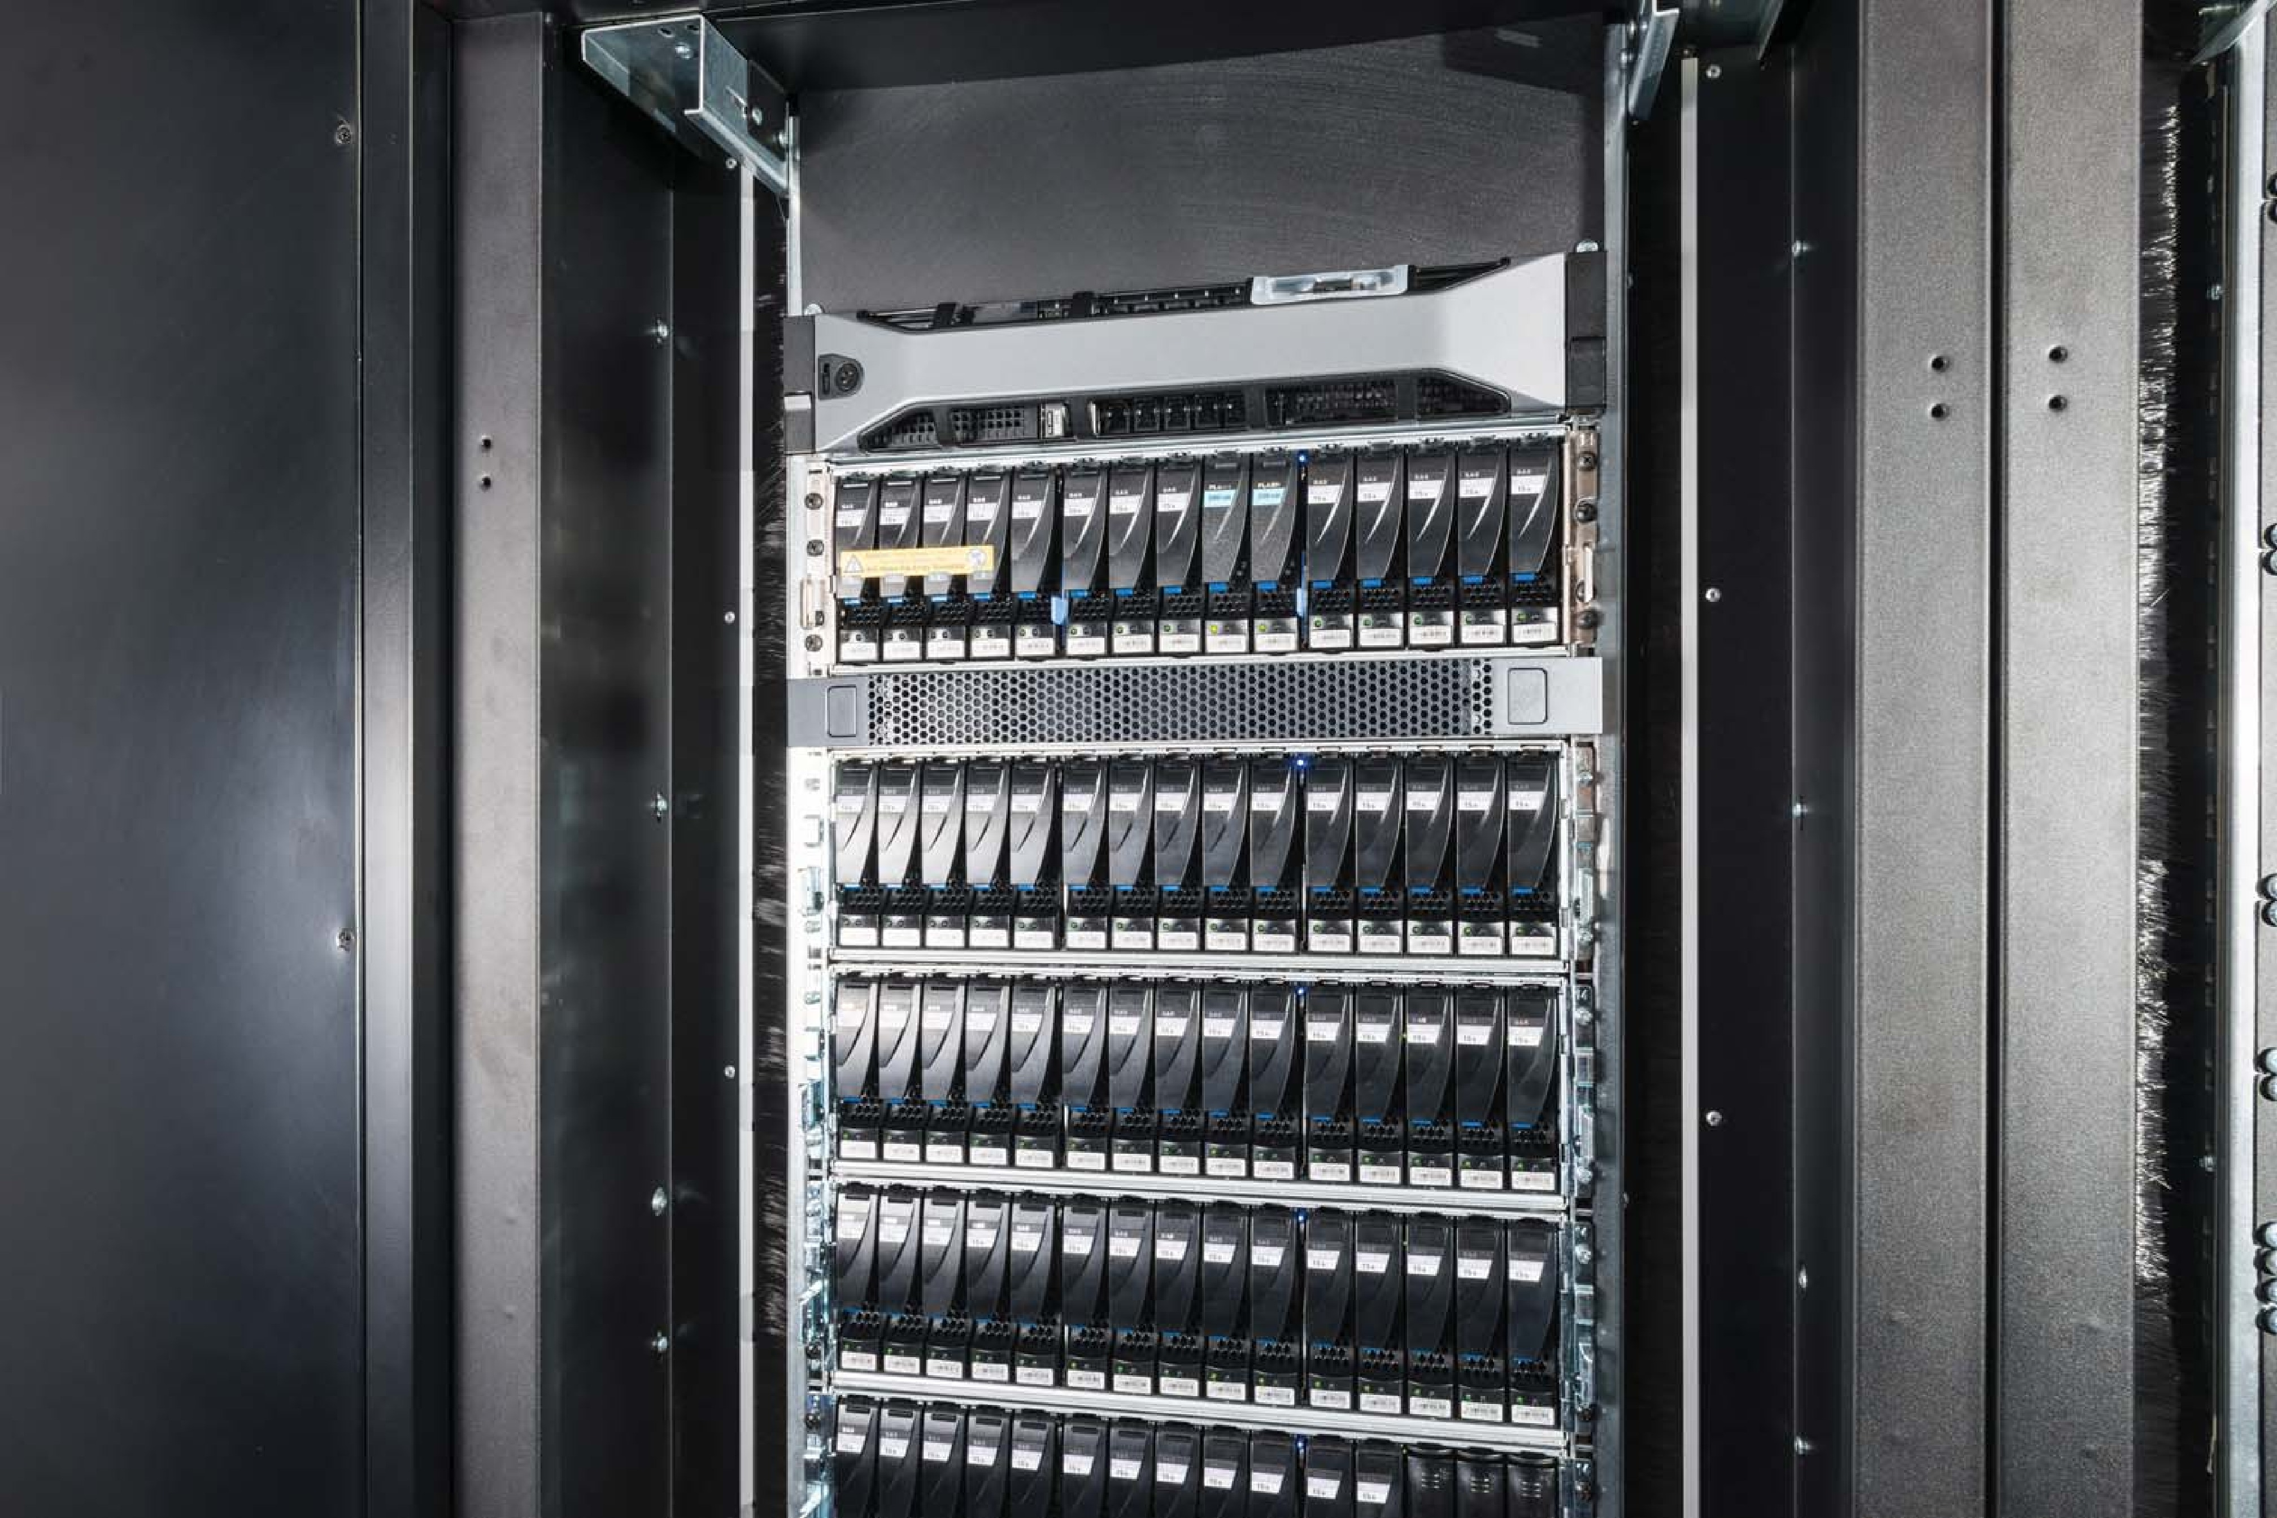
Storage Area Network (Cont.)
SAN is one or more storage arrays
Connected to one or more Fibre Channel switches or InfiniBand (IB) network
Hosts also attach to the switches
Storage made available via LUN Masking from specific arrays to specific servers
Easy to add or remove storage, add new host and allocate it storage
Why have separate storage networks and communications networks?
Consider iSCSI, FCOE
A Storage Array

Slide 41
RAID Structure
RAID – redundant array of inexpensive disks
multiple disk drives provides reliability via redundancy
Increases the mean time to failure
Mean time to repair – exposure time when another failure could cause data loss
Mean time to data loss based on above factors
If mirrored disks fail independently, consider disk with 1300,000 mean time to failure and 10 hour mean time to repair
Mean time to data loss is 100, 000² / (2 ∗ 10) = 500 ∗ 10⁶ hours, or 57,000 years!
Frequently combined with NVRAM to improve write performance
Several improvements in disk-use techniques involve the use of multiple disks working cooperatively

Slide 42
RAID (Cont.)
Disk striping uses a group of disks as one storage unit
RAID is arranged into six different levels
RAID schemes improve performance and improve the reliability of the storage system by storing redundant data
Mirroring or shadowing (RAID 1) keeps duplicate of each disk
Striped mirrors (RAID 1+0) or mirrored stripes (RAID 0+1) provides high performance and high reliability
Block interleaved parity (RAID 4, 5, 6) uses much less redundancy
RAID within a storage array can still fail if the array fails, so automatic replication of the data between arrays is common
Frequently, a small number of hot-spare disks are left unallocated, automatically replacing a failed disk and having data rebuilt onto them

Slide 43
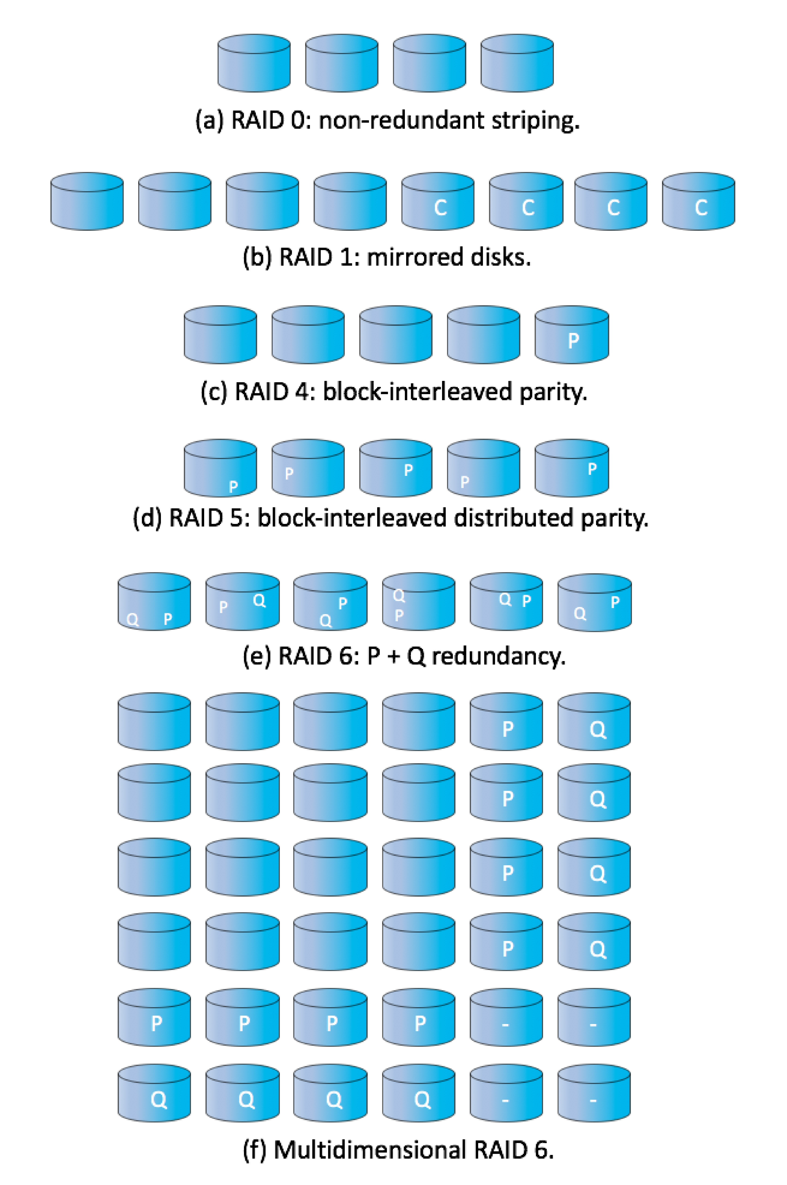
RAID Levels

Slide 44
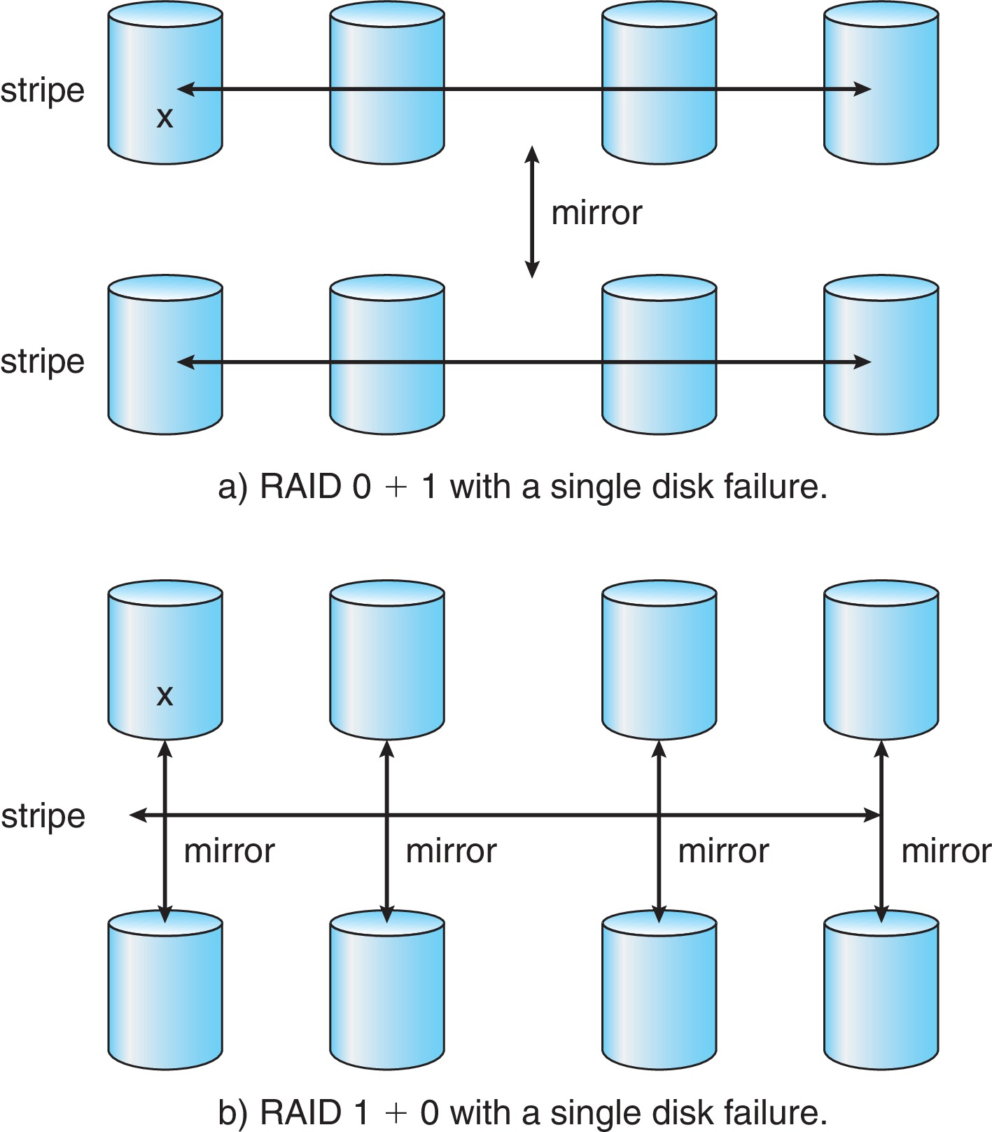
RAID (0 + 1) and (1 + 0)

Slide 45
Other Features
Regardless of where RAID implemented, other useful features can be added
Snapshot is a view of file system before a set of changes take place (i.e., at a point in time)
More in Ch 12
Replication is automatic duplication of writes between separate sites
For redundancy and disaster recovery
Can be synchronous or asynchronous
Hot spare disk is unused, automatically used by RAID production if a disk fails to replace the failed disk and rebuild the RAID set if possible
Decreases mean time to repair

Slide 46
Extensions
RAID alone does not prevent or detect data corruption or other errors, just disk failures
Solaris ZFS adds checksums of all data and metadata
Checksums kept with pointer to object, to detect if object is the right one and whether it changed
Can detect and correct data and metadata corruption
ZFS also removes volumes, partitions
Disks allocated in pools
Filesystems with a pool share that pool, use and release space like malloc() and free() memory allocate / release calls
ZFS checksums all metadata and data

Slide 47
Traditional and Pooled Storage

Slide 48
Object Storage
General-purpose computing, file systems not sufficient for very large scale
Another approach – start with a storage pool and place objects in it
Object just a container of data
No way to navigate the pool to find objects (no directory structures, few services
Computer-oriented, not user-oriented
Typical sequence
Create an object within the pool, receive an object ID
Access object via that ID
Delete object via that ID

Slide 49
Object Storage (Cont.)
Object storage management software like Hadoop file system (HDFS) and Ceph determine where to store objects, manages protection
Typically by storing N copies, across N systems, in the object storage cluster
Horizontally scalable
Content addressable, unstructured

Slide 50
End of Chapter 11

